Slide 1
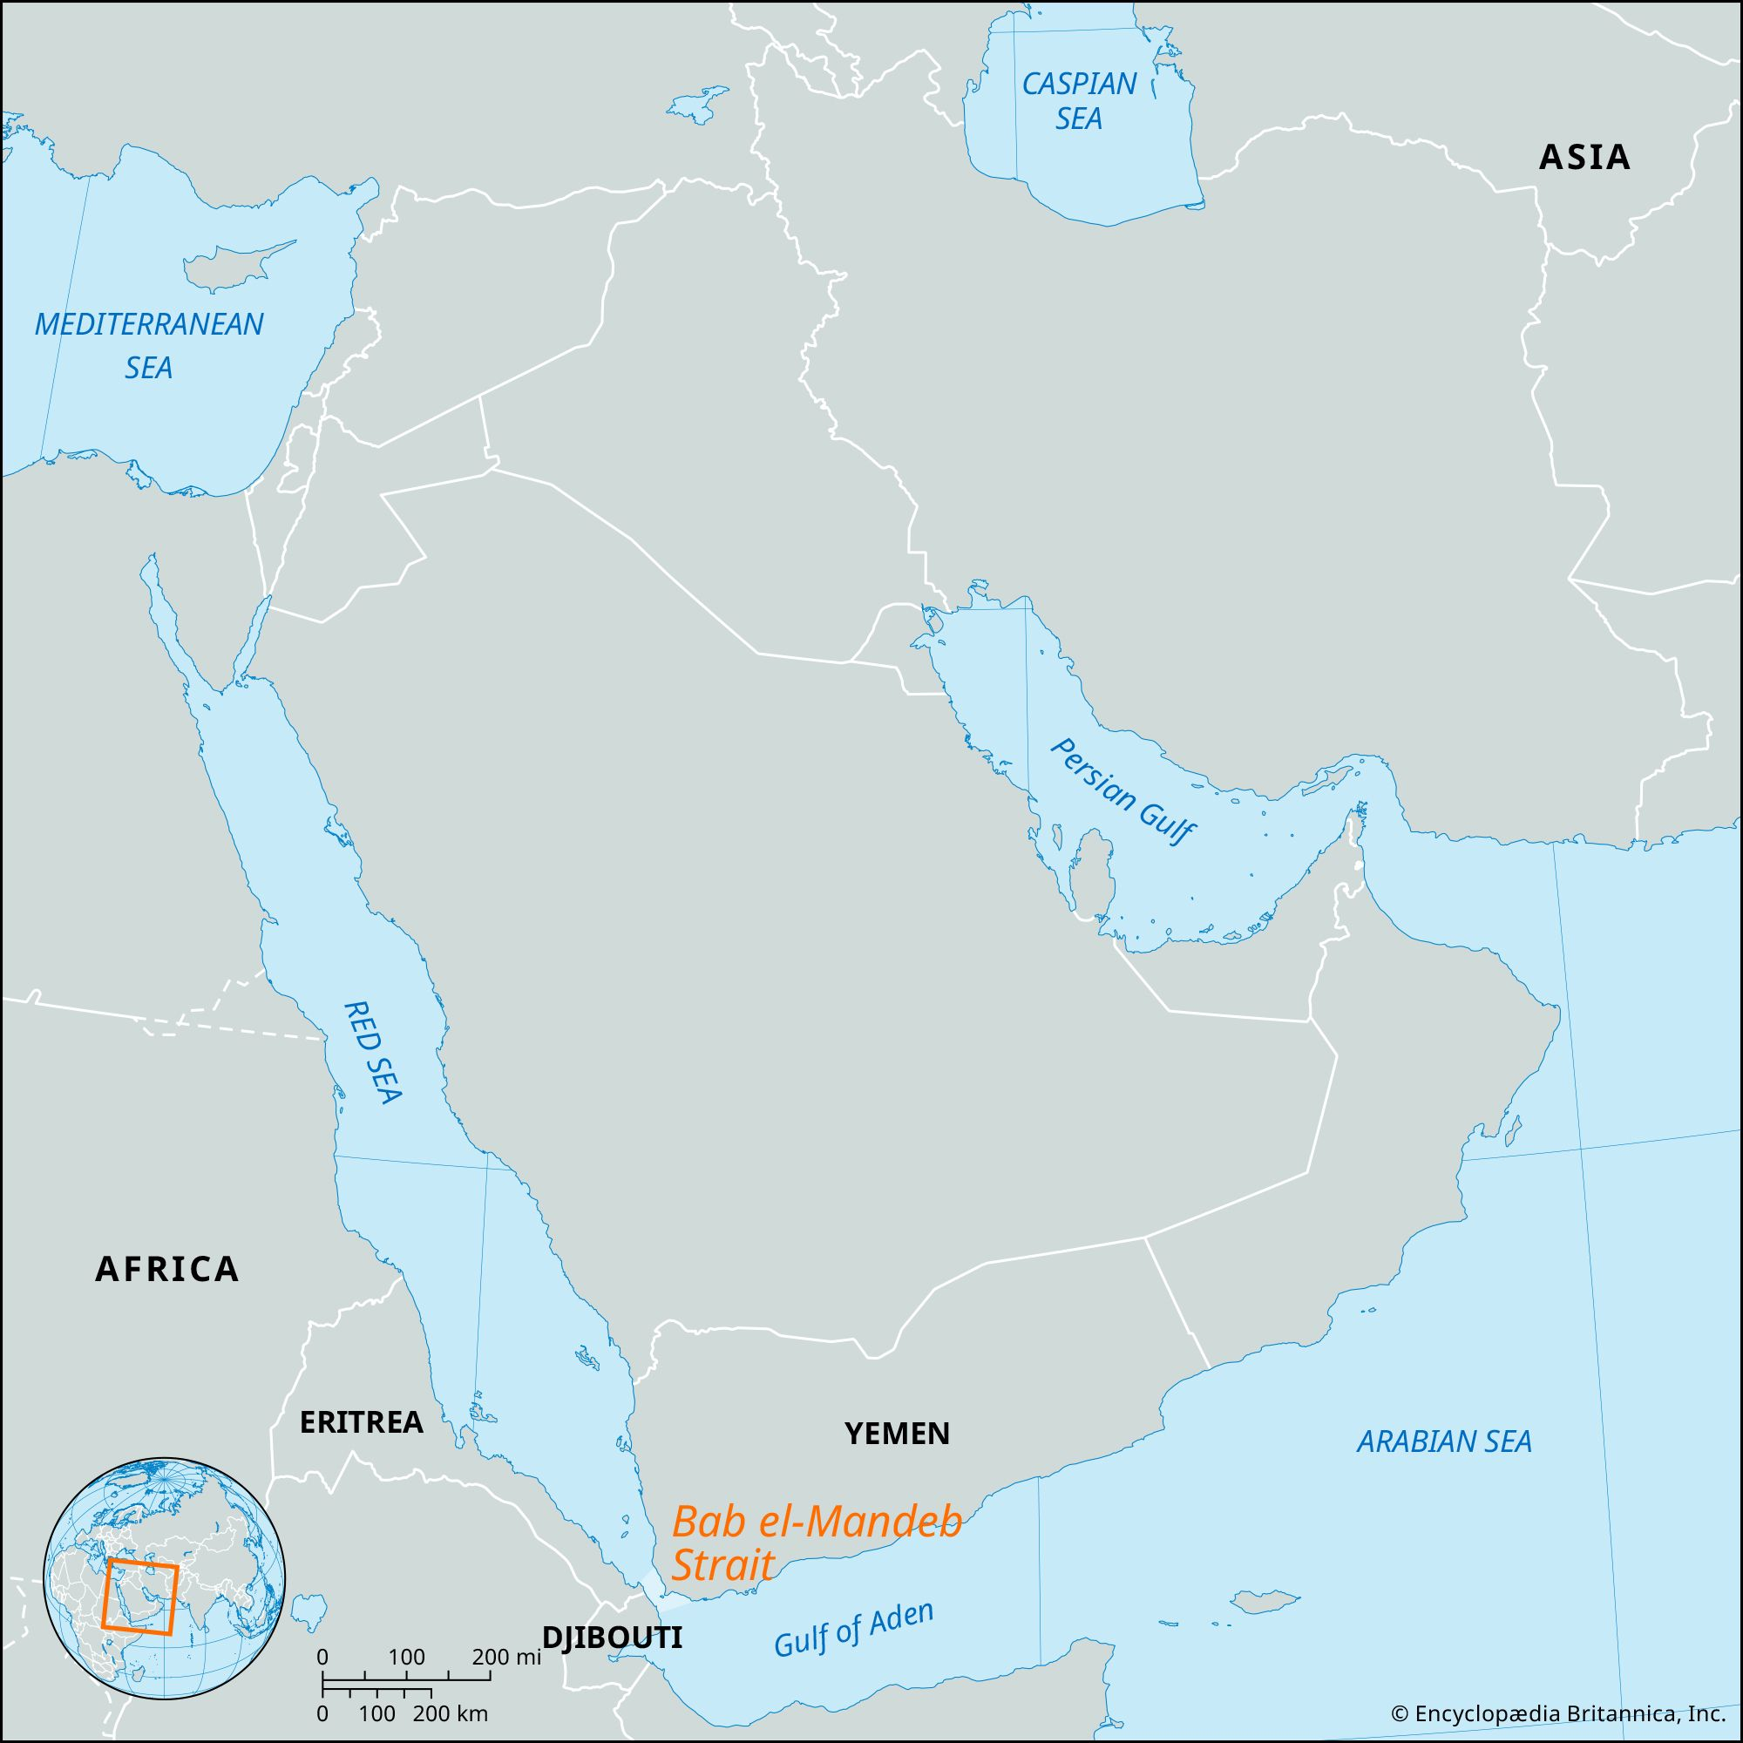
Out of Africa
López, S., Van Dorp, L. and Hellenthal, G. (2015) ‘Human dispersal out of Africa: A lasting debate’, Evolutionary Bioinformatics, 11s2. doi:10.4137/ebo.s33489.
(López, Van Dorp and Hellenthal, 2015)
Dispersal from Africa is thought to have occurred between 70-80kya due to evidence of favourable climatic conditions, human tools in south-east Asia as well teeth dating to 80kya. It must be noted there are also signs of earlier failed dispersals such as the remains at Skhul and Qafzeh hominins in the Levant dated as early as 120kya.
Northern Route – Sinai Peninsula
Southern Route – Bab el-Mandeb
125 Ethiopian and 100 Egyptian genomes were sequenced and any DNA thought to have been inherited from more recent non-African sources was removed. It was found that genes in non-African Europeans appeared to be inherited from Egyptians indicating that people dispersed through the Sinai Peninsula. However, it must be noted that using extant DNA for studies such as these despite the precautions taken means that results could be misleading due to factors such as population replacement, migrations or genetic drift.
Evidence from Mitochondrial DNA suggests that haplogroup L3 migrated from horn of Africa and the analysis of three west-Eurasian haplogroups found some attributes that suggest Arabian ancestry and dispersal from Bab el-Mandeb. Further evidence supporting dispersal from the Southern route from genomic data supporting a single wave serial bottleneck where a small population crossed the mouth of the red sea into the Arabian peninsula and expanded resulting in the population of the rest of the world.
Sinai Peninsula
Encyclopaedia Britannica Inc.

